Slide 1
Use of Machine Learning for Financial Fraud Detection

Slide 2
AGENDA
Top Financial Frauds in World
Global Payment Fraud Statistics
Fraud Detection Techniques
Use Cases
ML Model
Description of Data
Data Preprocessing
Feature Selection
Model Building
Evaluation Metric and Model Performance
Important Features

Slide 3
Top Financial Frauds in World
More than 100 million Capital One accounts compromised
In one of the largest thefts of bank data, Capital One server was hacked and personal data of over 100 million people was compromised
$7.4 billion accounting fraud at Steinhoff
Wells Fargo Forced To Pay $3 Billion For The Bank’s Fake Account Scandal
Notes:
These are some of the top financial frauds in the world.
Capital One is one of the most prominent bank, whose server was hacked and personal data of over 100 million people was compromised.
In an accounting fraud in Steinhoff, carried by the executives of the company for a duration of 8 years. Around 7 billion was lost. “A small group of Steinhoff Group former executives and other non-Steinhoff executives, led by a senior management executive, structured and implemented various transactions which had the result of substantially inflating the profit and asset values of the Steinhoff Group over an extended period.”
Wells Fargo - To be fair, it's clearly the fault of company higher-ups that employees at Wells Fargo were given impossibly high sales goals that rose like clockwork from 2002 to 2016. But to meet these quotas, employees at the bank were incentivized to open fake accounts under customers' names – if a customer opened a savings account at the bank, employees might surreptitiously open a credit card under that customer's name as well. Short-term profits soared thanks to more than 2 million of these fake accounts, but it wasn't worth it in the long run.

Slide 4
Global Payment Fraud Statistics
47% of companies said they had experienced fraud in the past 2 years
39% of reported frauds were committed by external perpetrators
37% of reported frauds were committed by internal perpetrators
20% of reported frauds were carried out by internal and external perpetrators colluding
Source - 2020 Global Economic Crime and Fraud Survey
Notes:
According to Global Payment Fraud Statistics released by 2020 global economic crime and fraud survey,
47% of companies said they had experienced fraud in the past 2 years
39% of reported frauds were committed by external perpetrators( like paid hackers, software engineers)
37% of reported frauds were committed by internal perpetrators ( like company’s top executives and employees)
20% of reported frauds were carried out by internal and external perpetrators colluding

Slide 5
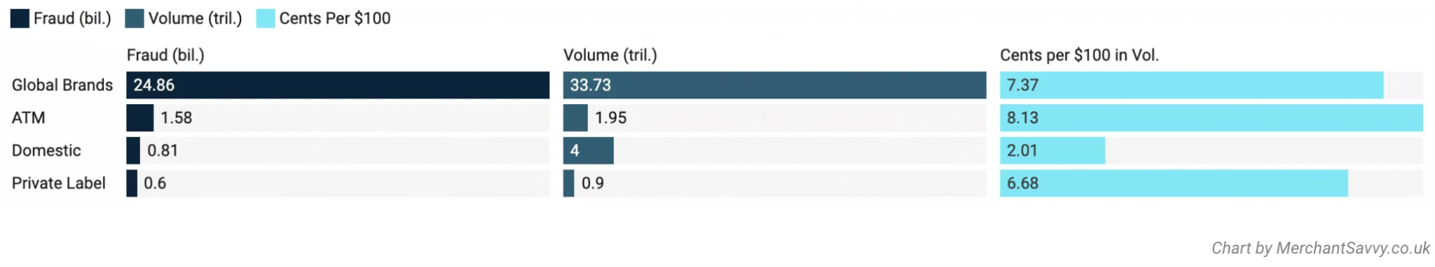
Worldwide fraud by card transaction type in 2018 ( Credits - The Nilson Report 2019)
Notes:
Transactions processed via the following card types:
Global Brands: Transactions processed via Visa, Mastercard, UnionPay, AmericanExpress, Diners, DIscover, and JCP.
ATM: Cirrus and Plus.
Domestic: Maestro, Elo, RuPay, Interac, Cartes Bancaires, Mir, and 82 others.
Private label: Includes store, gasoline, airline, medical, ACH debit cards, prepaid cards, etc.
According to the Nilson Report,
24.86 billion was lost to fraud out of total volume of transaction which is 33.73. This accounts for loss of 7.37 cents per 110$ is lost to fraud transaction.
Similarly out of a total volume of transaction carried out by ATM of volume 1.95 trillion. 1.58 billion was lost to fraud. This accounts to loss of 8.13 cent out of every 100$.
Out of 4 trillion transaction carried out by domestic players, 0.81 billion is lost to fraud. This accounts for 2.01 cent loss for every 100 dollar
Similarly out of total 0.9 trillion transaction carried out by private players, 0.6 billion is lost to fraudsters. This accounts for loss of 6.68 cents for every 100$.

Slide 6
Payment Fraud Losses have more than tripled since 2011 and are expected to exceed $40 Billion by 2027
Notes:
Payment fraud losses are expected to exceed $40 billion by 2027

Slide 7
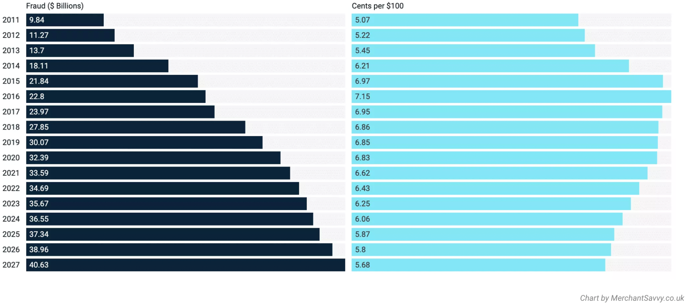
General Fraud losses worldwide (Credits - The Nilson Report 2019)
Notes:
Here is the stats for the point mentioned in slide6. In 2011 9.84 billion is lost to fraud transactions. This is projected to become 40 billion by 2027. In 2022 6.43 cent out of 100 $ is lost to fraud. As companies are increasingly investing in fraud detection techniques, so this number will decrease by 2027. But at the same time as more transactions will happen online, so the risk of fraud will increase and so we will loose around 40 billion by 2027.

Slide 8
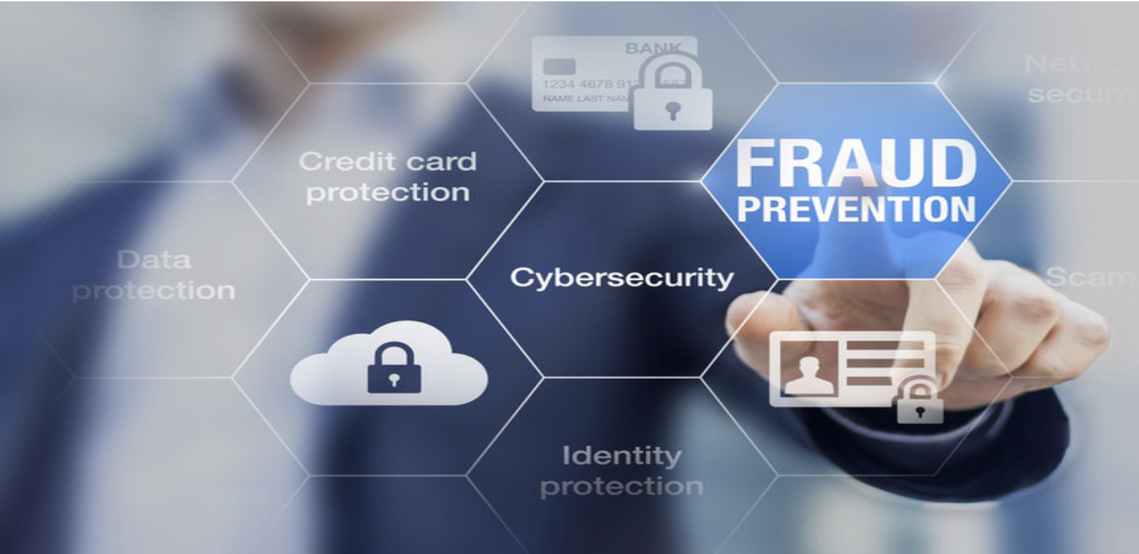
Fraud Detection Techniques
Integral Part of all Modern Financial Systems
Protect them from Chargebacks, Government Fees and Reputational Damage
Filters out majority of fraudulent transactions
Notes:
Fraud detection techniques have become an integral part of all modern financial systems. These techniques protect them from chargebacks, government fees and reputational damage. These techniques filters out majority of fraudulent transactions.

Slide 9
ROI of an effective fraud prevention program
Companies with set fraud prevention programs reduced their fraud attack response expenses by 42% and their remedy expenses by 17% compared to companies without these measures in place
Nearly 60% of companies that did conduct an investigation after a fraud attack ended up in a better place
Credits - PwC 2020 Global Economic Crime and Fraud Survey
Notes:
By instantiating fraud prevention techniques, companies have reduced a huge amount of operational cost. Like they have reduced their fraud attack response expense by 42% and expense on their remedial measures have reduced by 17%. Remedial measures may include legal cost, market share and others.

Slide 10
How are Global Banks dealing with Fraud?
70% of them are transaction monitoring the risk scores in real time
67% are using physical biometrics (voice, fingerprint, or facial recognition)
63% are using rules and machine learning for transaction monitoring
33% are using behavioural biometrics (studying patterns in human behaviour)
Credits - KPMG Global Banking Fraud Survey 2019
Notes:
Global banks are employing multiple ways to deal with fraud. According to the percentage stats given here, an individual bank is employing more than one technique to deal with fraud. It is possible that a bank is using risk score, physical biometric as well as machine learning to detect and prevent fraud.
70% of them are transaction monitoring the risk scores in real time
67% are using physical biometrics (voice, fingerprint, or facial recognition)
63% are using rules and machine learning for transaction monitoring
33% are using behavioural biometrics (studying patterns in human behaviour)

Slide 11
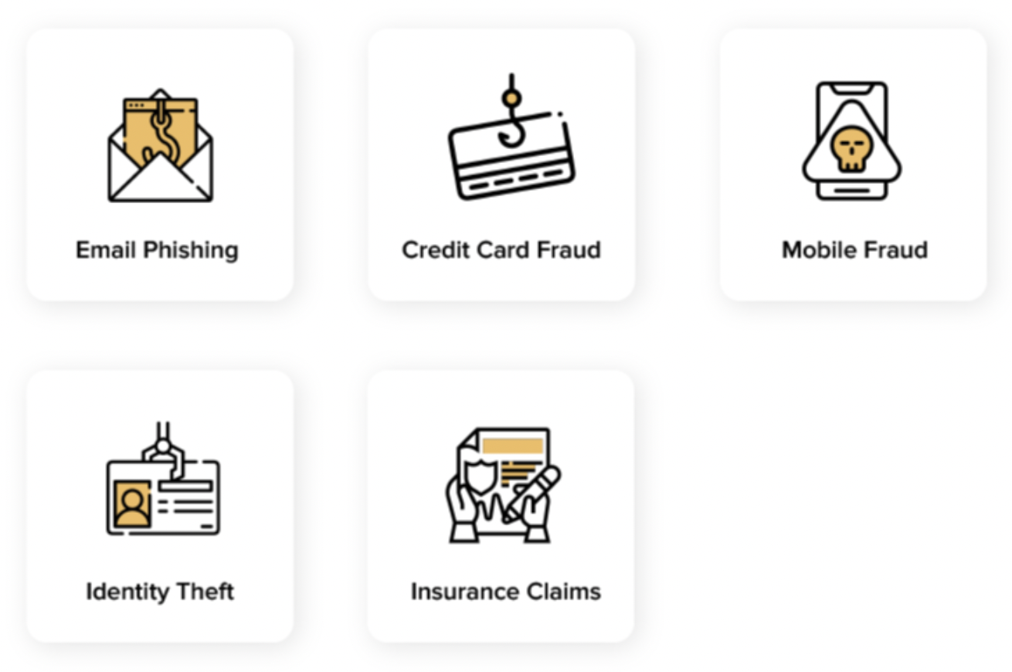
Use Cases
Notes:
ML has been employed in prevention and detection of fraud transaction. These are various domain in which ML has been employed. Like ML is used in the area of email phishing, credit card fraud, mobile fraud, identity theft and insurance claims fraud.

Slide 12
Email Phishing:-
Use automated methods to detect phishing using Machine Learning
Notes:
Email Phishing - Attackers send fake messages and websites link to users via email

Slide 13
Credit Card Fraud:-
ML helps identify which actions are authentic and which ones are illegal
Notes:
Credit Card Fraud - Steal debit card or credit card numbers through unsecured internet connections.

Slide 14
Mobile Fraud:-
Machine Learning helps detect abnormal activities for each user, thus minimizing mobile fraud risks
Notes:
Mobile Fraud - Smartphones are prone to hacking and cyber threats.

Slide 15
Identity Theft:-
ML helps examine identity documents in real-time to ensure all fraud cases are detected by enabling methods like Face Recognition
Notes:
Identity theft - Identity theft puts both individuals and enterprises at risk

Slide 16
Insurance Fraud:-
ML uses superior pattern recognition capabilities helps resolve insurance claims with utmost accuracy and find fake claims
Notes:
Insurance Fraud - It includes fake claims of car damage, property and even unemployment.

Slide 17
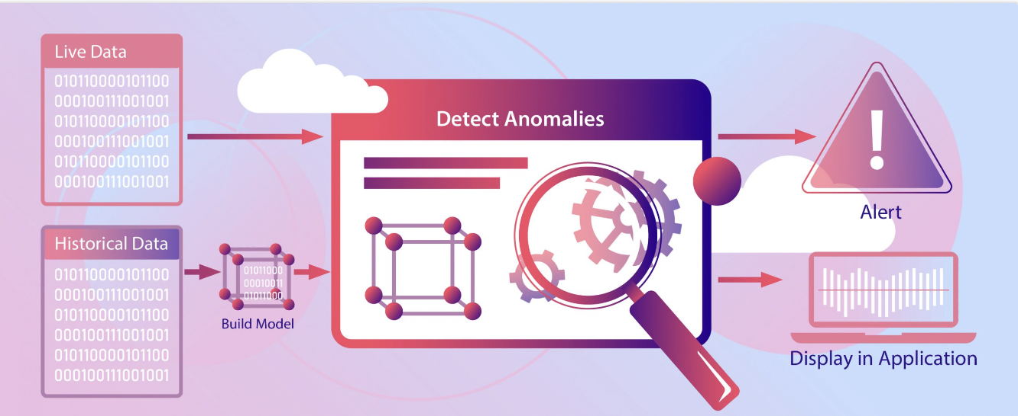
Financial Fraud Detection Machine Learning Model
Notes:
This is a Machine Learning model built on Synthetic dataset. The following slides include description of the model.

Slide 18
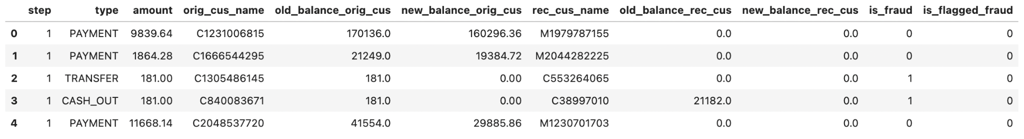
Description of Data
Synthetic Dataset generated by PaySim mobile money simulator
Shape of data - 6362620 rows, 11 columns ( 3 categorical + 8 Numerical)
Notes:
This slides describes the kind of data we are using. The dataset is a simulated data, where fraud instances are deliberately inserted. This huge dataset contains around 6 million data points. It contains 3 categorical and 8 numerical values. The categorical features include type of transaction, name of original and receiving customer. The target variable is is_fraud. It is 1 whenever fraud transaction has occurred, else 0.

Slide 19
step | type | amount | orig_cus_name | old_balance_orig_cus | new_balance_orig_cus | rec_cus_name | old_balance_rec_cus | new_balance_rec_cus | is_fraud | is_flagged_fraud
Maps a unit of time in real world | Type of transaction | Amount of transaction | Name of original customer | Balance of customer before transaction | Balance of customer after transaction | Name of receiving customer | Balance of receiving customer before transaction | Balance of receiving customer after receiving transaction | Target variable | True, when more than 200,000 transferred in single transaction
Notes:
This table describes each column present in data.
Step - Maps a unit of time in real world
Type - type of transaction, whether cash was taken out, or transferred, or deposited or debited.
Amount - it represents amount of transaction
Orig_cus_name - it represents name of original customer, the initiating customer. Amount is deducted or transferred from his account.
Old_balance_orig_cus - this is the balance of original customer before the transaction was carried out
New_balance_orig_cus - balance of original customer after the transaction was carried out.
Rec_cus_name - Name of the customer who received the amount either through transfer or deposit.
Is_fraud - this is the target variable. We have scrutinised both “is_fraud” and “is_flagged_fraud”, and found that there is a lot of discrepancy in “is_flagged_fraud”.
Is_flagged_fraud - this is based on the rule, where it is 1 when more than 200,000 transferred in single transaction

Slide 20
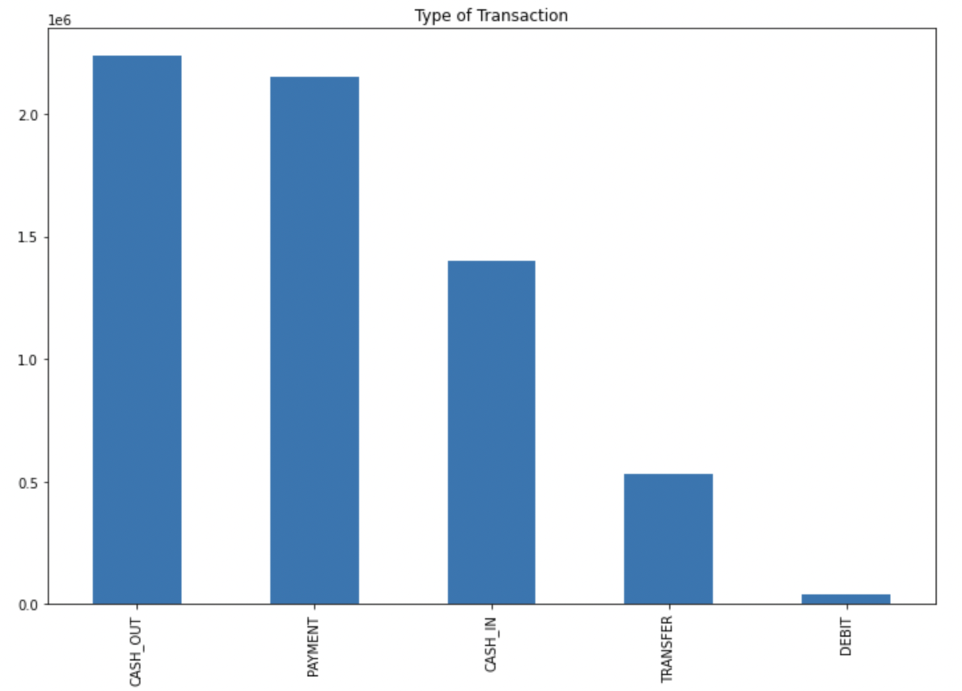
Plot on Type of Transaction
Notes:
Highest number of transactions are of type when cash is taken out of the system.

Slide 21
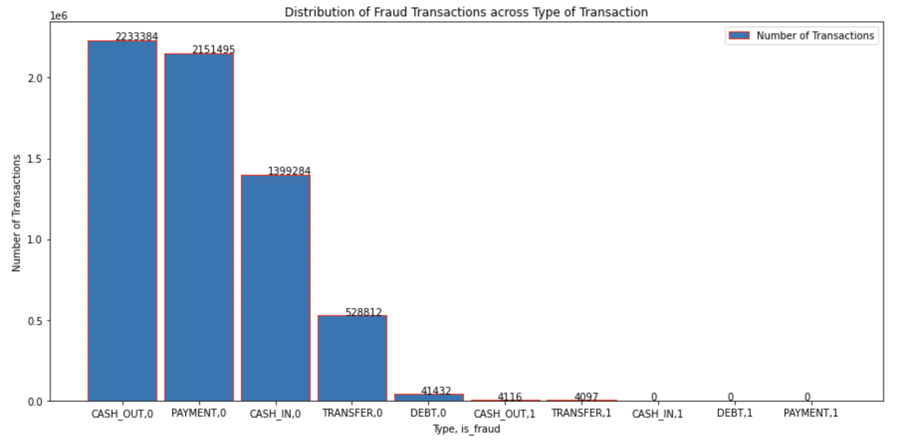
Distribution of Fraud Transactions across Type of Transaction
Notes:
Fraud transactions have occured in only two type of transactions, which are
when cash is taken out - "CASH_OUT"
or when cash is transferred - "TRANSFER"

Slide 22
Description of Data
Fraud transactions have occurred in only two type of transactions which are -
“CASH_OUT” - When cash is taken out of account
“TRANSFER” - When Cash is transferred to another account
Fraud is flagged 16 times (amount > 200,000)
Discrepancy in “is_flagged_fraud” - Fraud is not flagged 76% of time despite of amount > 200,000
Number of Fraud Transactions = 8213

Slide 23
Data Preprocessing
Created New Features which store first letter of original customer name and receiving customer name => indicates whether account holder is merchant or not
Fraud occurs only in “TRANSFER” and “CASH_OUT” type of transaction. Model is trained and tested on only these type of transaction
Dropped Customer names and Flag column
Encoded categorical columns
Created new features which represent error in account balance of original and receiving customer
Scaled the data using Robust Scaling, and stored them separately
Avoided data leakage by fitting the scaler on train data and predicting it on test data

Slide 24
Feature Selection
Removed Constant and Quasi Constant Features
Removed Correlated Features
Number of features selected as input to the model are 14
Number of rows in training data - 2216327 (80%)
Number of rows in test data - 554082 (20%)
Train and Test data are stratified based on number of times fraud transaction has occurred
% of Fraud transaction in train and test data = 0.29%

Slide 25
Model Building
XGBoost Classifier model is used because :-
We have large number of observations in training data
Number of features is smaller than number of observations in training data
It includes different regularization penalties to avoid overfitting
It can detect and learn from non-linear data patterns
Other Tree Based algorithms like Light GBM, Random Forest didn’t perform well
Notes:
Here are the arguments in favour of why we used XGBoost classifier model.

Slide 26
Evaluation Metric and Model Performance
The data is highly skewed, so we are using Area Under The Precision Recall Curve instead of AUROC as an Evaluation Metric
Score on Train data - 0.998
Score on Test data - 0.982
Model is performing well on Non Fraud Transaction in compare to Fraud Transaction
The Type of Transaction came out to be the most important feature

Slide 27
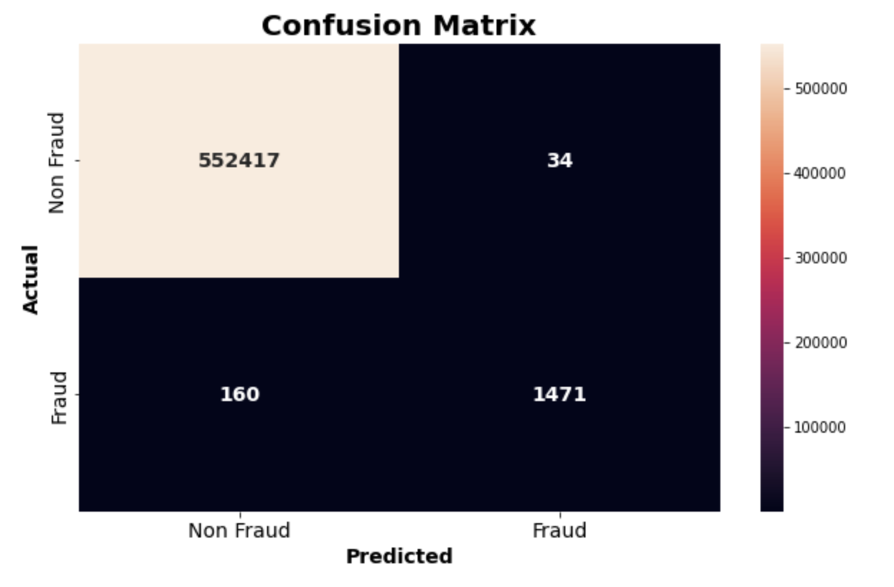
Confusion Matrix
Notes:
From the confusion matrix we can see that the model is highly accurate in predicting non-fraud transactions, as they form majority.

Slide 28
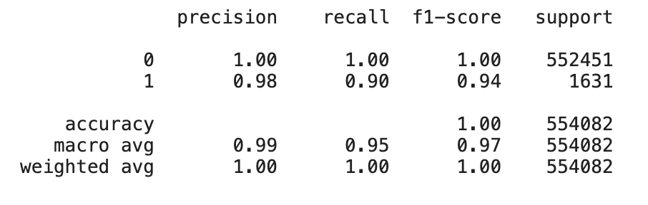
Classification Report
Notes:
0 - represents valid transaction, while 1 represents fraud transaction.
Scores for valid transaction are comparably higher than those of fraud transaction.
(0- Valid Transaction, 1 - Fraud Transaction)

Slide 29
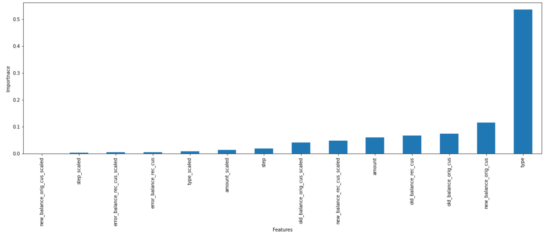
Important Features
Notes:
From the feature importance table, the variable type of transaction has come out as the most important feature.
Encoded "type" column. Whenever type == Transfer, it is 1 else it is 0. We can add some insights in favour of it from graphviz plot. Most of the time split is made based on values of type column.

Slide 30
Thank You!

